Slide 1
Healthcare Analysis
PATIENTS TRENDS, BILLING & HOSPITAL PERFORMANCES

Slide 2
OBJECTIVES
This report covers:
Analysis of patient demographics and trends
Identification of common medical conditions
Evaluation of test results and hospital stay patterns
Assess billing and insurance performance
Provide insights for better healthcare decisions

Slide 3
DATASET OVERVIEW
The dataset includes patient-level healthcare data covering demographics, medical conditions, hospital admissions, test results, and billing information, which was used to analyze patient trends and hospital performance.
The dataset spans multiple hospitals and supports analysis across different conditions and admission types.
It provides both clinical and financial insights, enabling evaluation of patient outcomes and hospital revenue patterns.
The dataset contains over 55,000 patient records, giving a strong sample size for meaningful analysis.
On average, patients incur moderate healthcare costs, suggesting fairly consistent billing patterns across cases.
Patients typically spend about two weeks in the hospital, indicating the dataset includes both moderate and serious cases.
More than half of the patients recorded abnormal test results, which suggests a high level of medical attention is required across cases

Slide 4
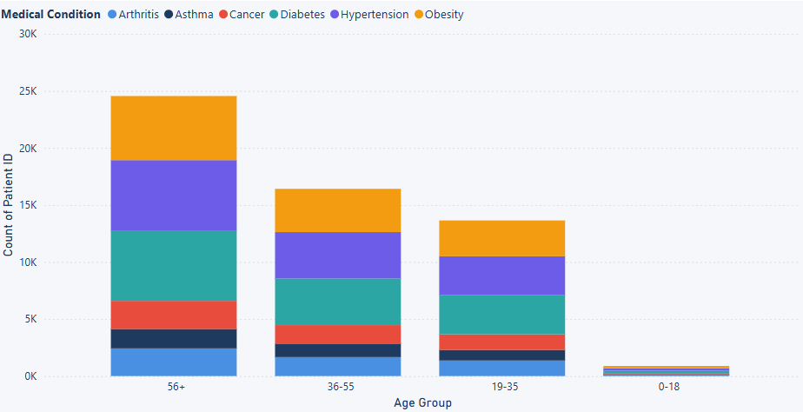
KEY INSIGHT
1. Age group & Medical condition
The older age group (56+) records the highest number of patients across most medical conditions, indicating that healthcare demand increases with age.
Younger age groups (0–18) have significantly lower patient counts, showing fewer hospital visits or less severe conditions.
Chronic conditions appear more concentrated in older age groups, especially 56+.

Slide 5
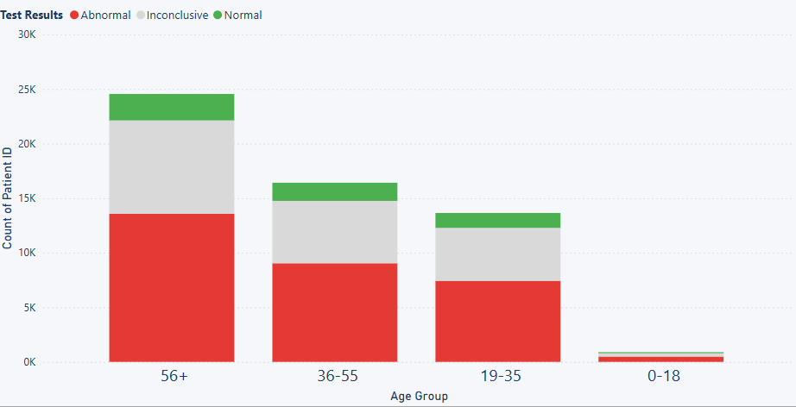
KEY INSIGHT
2. Age & Test Results
Abnormal test results are more common across all age groups, especially among older patients, reinforcing the link between age and health complications.
However, younger groups show fewer abnormal cases, suggesting generally better health conditions.
The gap between normal and abnormal results becomes more noticeable with increasing age.

Slide 6
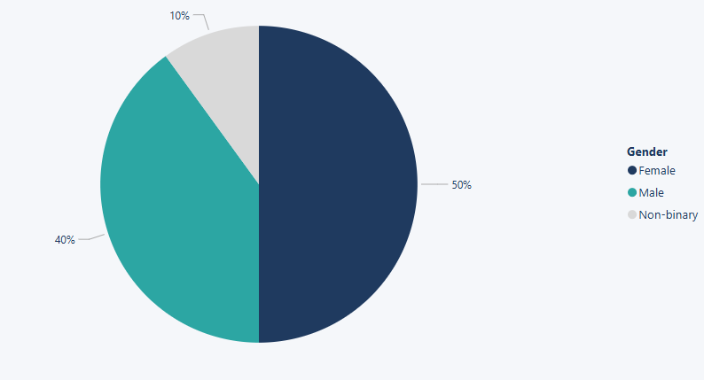
KEY INSIGHT
3. Gender distribution
The gender distribution is fairly balanced, although one group slightly dominates, indicating no major gender bias in hospital admissions.
The slight variation between genders suggests healthcare demand is fairly evenly spread.
No single gender overwhelmingly dominates, indicating balanced access to healthcare services.

Slide 7
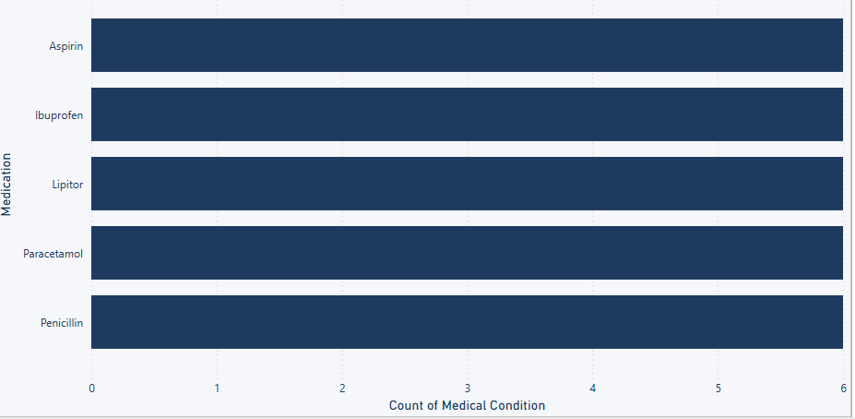
KEY INSIGHT
4. Medication Usage
Medications such as Aspirin, Ibuprofen, and Paracetamol are widely used across conditions, suggesting they are common treatments for multiple illnesses.
The medications shown are likely general-purpose drugs used across multiple conditions.
The similar usage levels suggest no single medication is overwhelmingly dominan

Slide 8
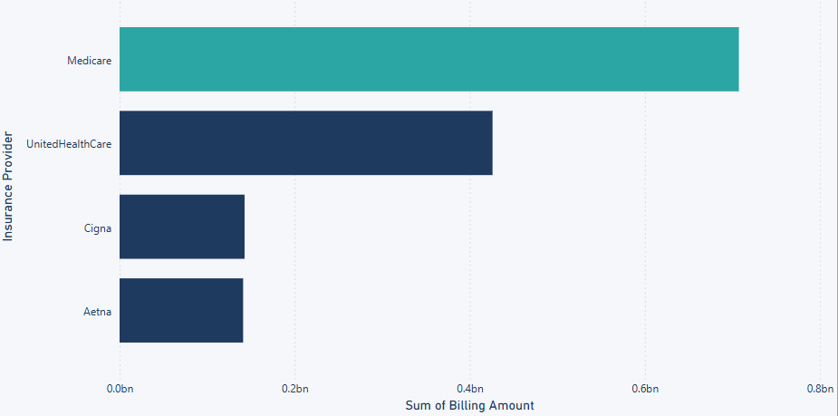
KEY INSIGHT
6. Billing by Insurance provider
Some insurance providers contribute significantly more to total billing, likely due to a higher number of insured patients or more expensive treatments.
The variation in billing suggests differences in coverage levels or patient volume per provider.
Top providers may be linked to hospitals with higher patient inflow or more expensive treatments.

Slide 9
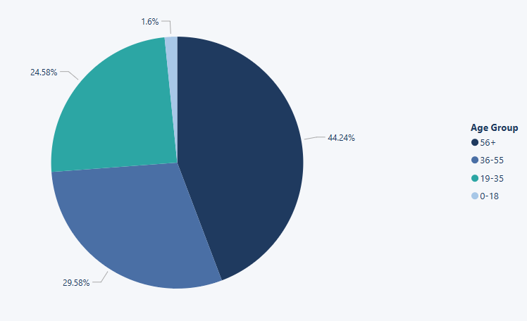
KEY INSIGHT
7. Age group distribution
The 56+ age group represents the largest portion of patients, confirming that older individuals make up the majority of hospital visits.
The steady increase in patient count with age highlights the impact of aging on health.
The smallest share from younger patients reinforces lower hospital dependency at early ages.

Slide 10
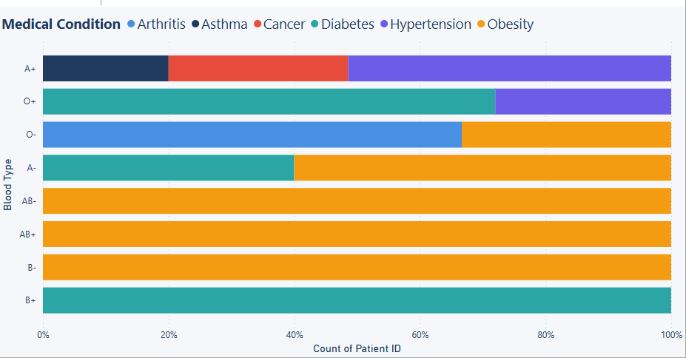
KEY INSIGHT
8. Blood type & Medical conditions
There is no very strong or obvious pattern between blood type and medical condition, but some blood groups appear more frequently across certain conditions.
While some blood types appear more frequent, the differences are not extreme.
This suggests medical conditions are not strongly dependent on blood group in this dataset.

Slide 11
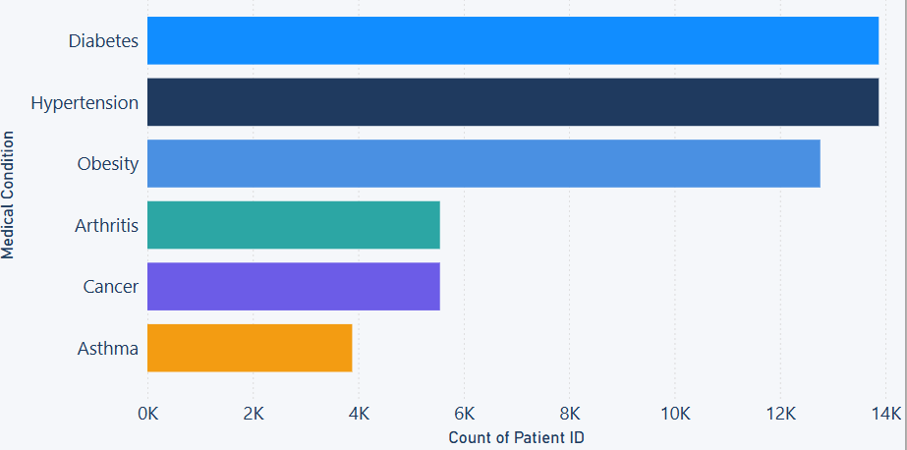
KEY INSIGHT
9. Medical conditions Distribution
Conditions like Diabetes and Hypertension are the most common, indicating they are major contributors to hospital admissions.
A few conditions dominate the dataset, showing where most healthcare resources are spent.
Less common conditions still contribute but at a much smaller scale.

Slide 12
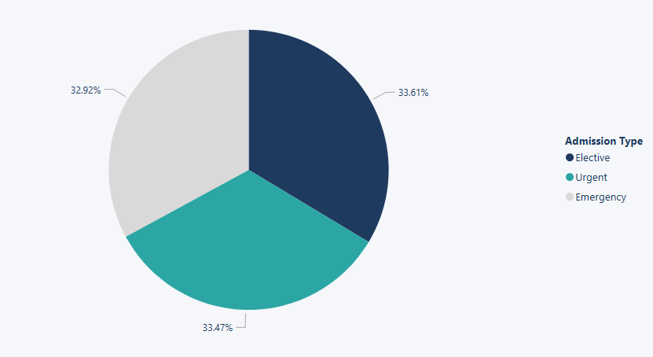
KEY INSIGHT
10.Admission Type
Emergency, urgent, and elective admission are fairly evenly distributed, suggesting hospitals handle a balanced mix of planned and unplanned
The near equal distribution indicates hospitals handle both planned and emergency care efficiently
It also suggests no single admission type is putting excessive pressure on the system.

Slide 13
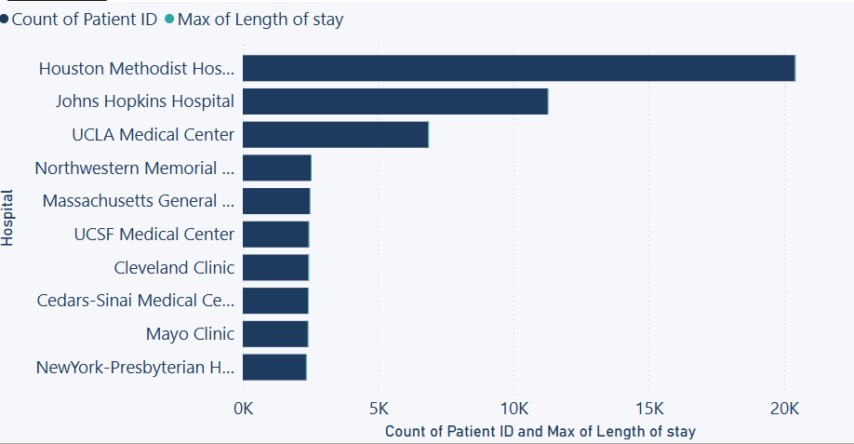
KEY INSIGHT
11. Hospital Performance
Some hospitals handle significantly more patients than others, indicating differences in capacity, reputation, or specialization.
A few conditions dominate the dataset, showing where most healthcare resources are spent.
Less common conditions still contribute but at a much smaller scale.

Slide 14
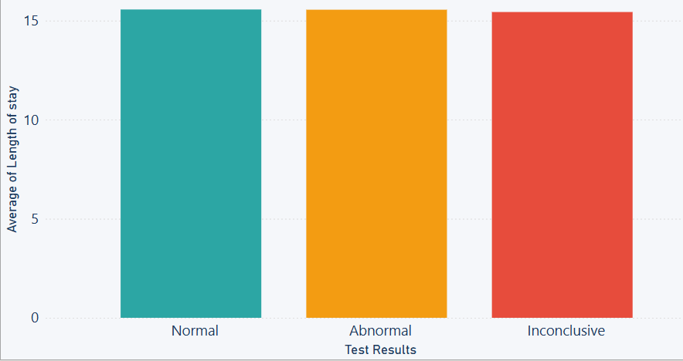
KEY INSIGHT
12. Length of stay Vs Test result
There is little variation in average length of stay across test result categories, indicating that abnormal results do not always lead to longer hospitalization.
The small variation indicates that test results alone do not determine recovery time.
Other factors like condition severity and treatment type likely play a bigger role

Slide 15
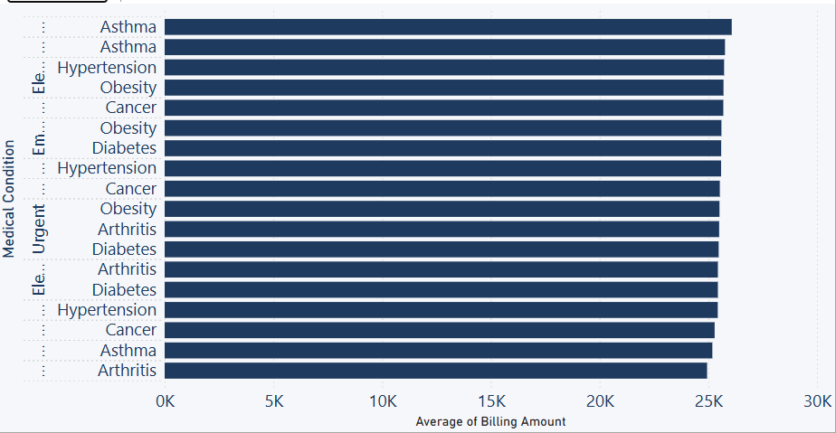
KEY INSIGHT
13. Billing by Admission type & Condition
Billing amounts are fairly similar across admission types, though certain medical conditions tend to incur slightly higher costs.
Costs remain relatively stable across admission types, indicating consistent pricing structures.
Certain conditions may slightly increase billing due to complexity of treatment.

Slide 16
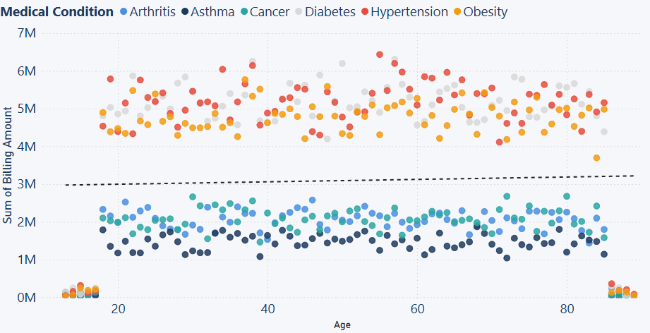
KEY INSIGHT
14. Billing Vs Age & Condition
Billing generally increases slightly with age, especially for chronic conditions, showing that older patients may require more expensive care.
There is a gradual upward trend in billing as age increases.
Variability within age groups shows that condition type also influences cost.

Slide 17
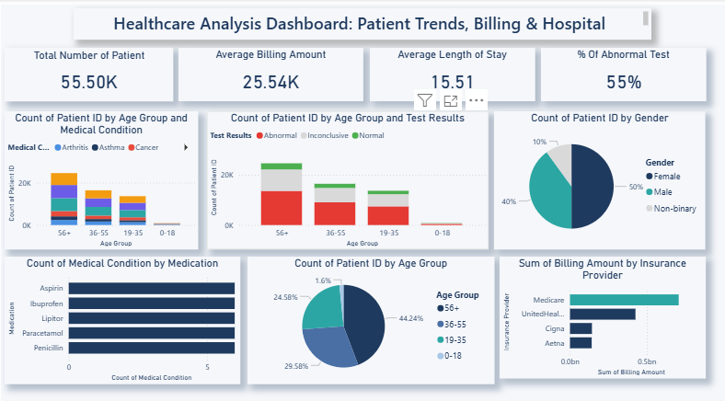
VISUALIZATION

Slide 18
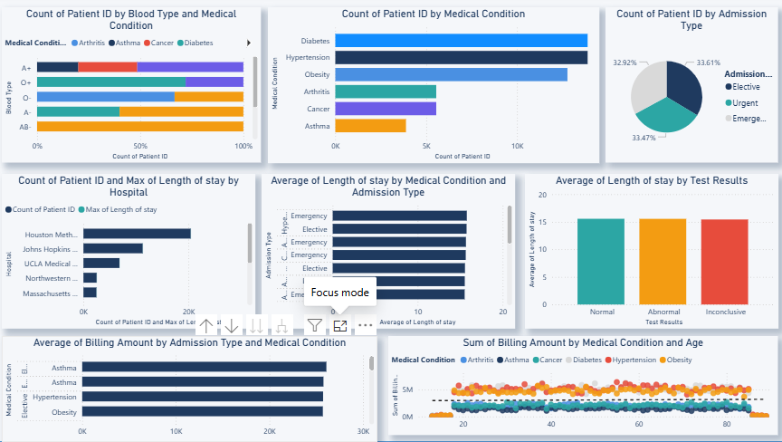
VISUALIZATION

Slide 19
RECOMMENDATION
Hospitals should prioritize care for patients aged 56+, as they represent the highest number of admissions.
Regular check-ups and preventive care can help reduce severe cases, this will improve patient outcomes and reduce pressure on hospital resources.
More attention should be given to managing conditions like diabetes and hypertension, this can be achieved through patient education and continuous monitoring.
Better management will help reduce frequent hospital visits and complications.
Hospitals should improve early testing and screening processes.
Since abnormal test results are high, early detection can prevent worsening conditions, this will lead to faster treatment and better recovery rates.
Hospitals with high patient numbers should be equipped with more staff and resources, this will help reduce workload pressure and improve service delivery. It ensures patients receive timely and efficient care.

Slide 20
RECOMMENDATION
Hospitals should strengthen relationships with key insurance providers, this can help improve revenue flow and billing efficiency.
Efforts should be made to reduce unnecessary delays in treatment, this will help shorten hospital stays and free up resources.
Efficient care improves both patient satisfaction and hospital performance.
Hospitals should ensure consistent treatment across all admission types.
Standardized procedures can improve efficiency and patient outcomes, this helps maintain quality care regardless of how patients are admitted.

Slide 21
CONCLUSION
This analysis highlights key patterns in patient demographics, medical conditions, and hospital operations. It shows that older patients and chronic conditions drive the majority of hospital activity, while abnormal test results are common but do not always lead to longer hospital stays.
Overall, the insights provide a strong foundation for improving patient care, optimizing hospital resources, and enhancing financial performance through better decision-making.
THANK YOU.

